Slide 1
Grover's Algorithm

Slide 2
Introduction
What is Grover’s algorithm?
An algorithm proposed by Lov Grover solves the problem of an unstructured search.
It is a quantum algorithm for finding the input value x*
of a function f(x) with f(x*) = 1 and f(x) = 0 for all other values of x.

Slide 3
What is Grover’s algorithm?
An example for a problem to use this algorithm is finding a phone number in an unsorted telephone directory.
You need N (number of entries) steps to get the right
answer (on average it may be N/2). With Grover’s algorithm, we can get the answer with a maximum of √N steps.
Another example is to find a specific card in a shuffled deck of N (say 52) cards.

Slide 4
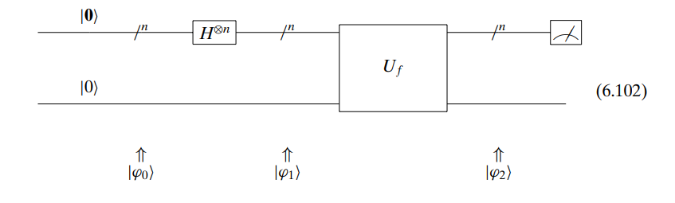

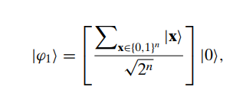


Main Idea

Slide 5

Algorithm Steps
Let all the N input states be represented with uniform superposition of all states (with n number of qubits and applying Hadamard gates) by 2ⁿ (N = 2ⁿ) qubits where n is an integer.
Let us define an Oracle function for our example, i.e., a function that returns
‘zero’ for all possible states, except one input state:

Slide 6
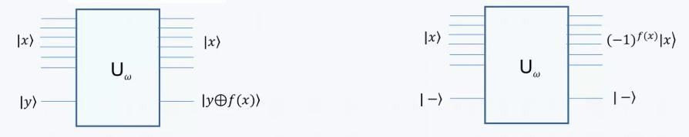
Algorithm Steps
The desired state will be caught. But the probability of measuring it correctly depends on its magnitude, which is 1/√N.

Slide 7

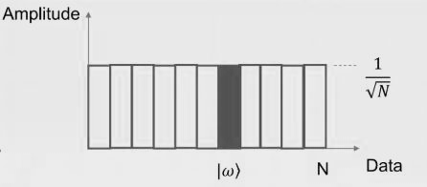
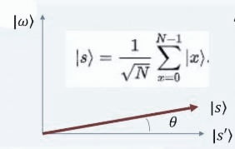
Algorithm Steps
Grover has given ways to improve (amplify) this amplitude:
State

Slide 8
Grover’s Two Tricks
Phase inversion(Phase Flip)
Inversion about the mean(Diffusion)

Slide 9
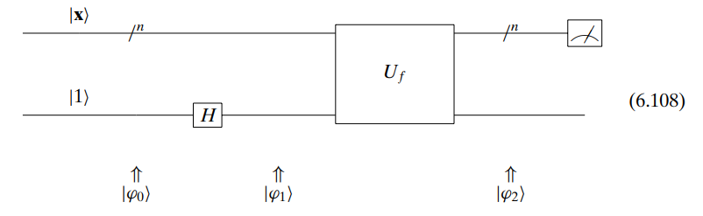



Phase inversion

Slide 10

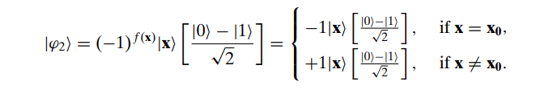

Slide 11
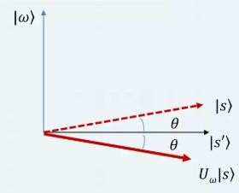
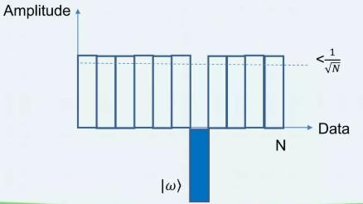
Diffusion
Shows rotation of |s> with respect to |s’>
Visuals of amplitude bars:
  Initially: All states have equal amplitude = 1/√N
  After amplification: Desired state gets a higher amplitude > 1/√N, while others are suppressed.

Slide 12
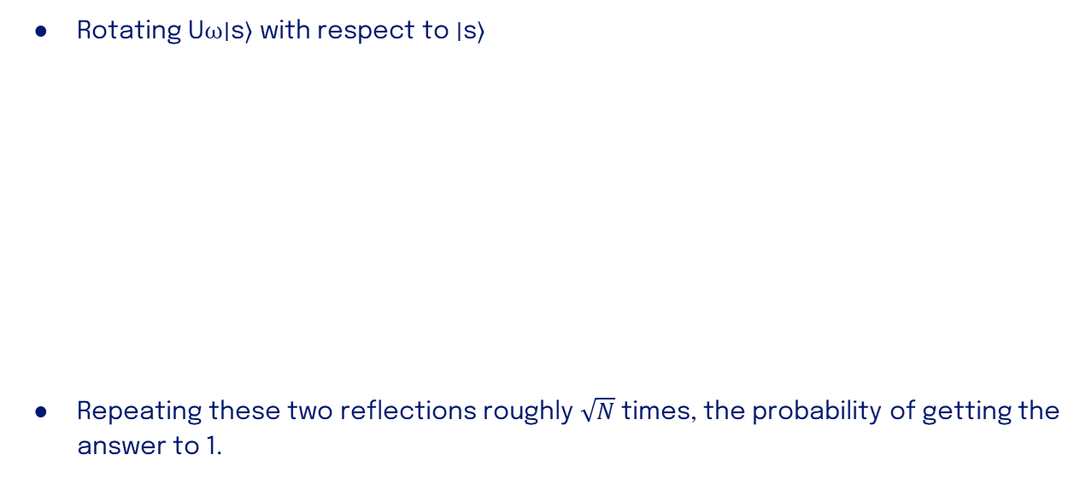
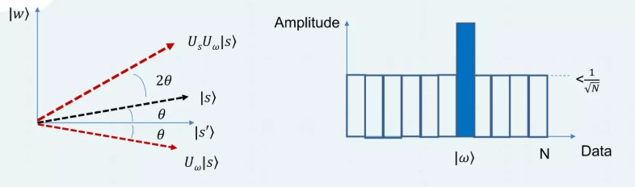
Algorithm Steps

Slide 13
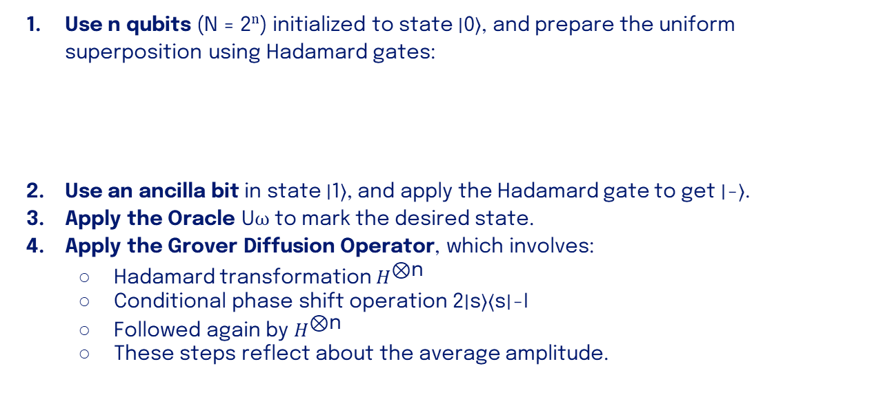

Algorithm’s steps
●

Slide 14
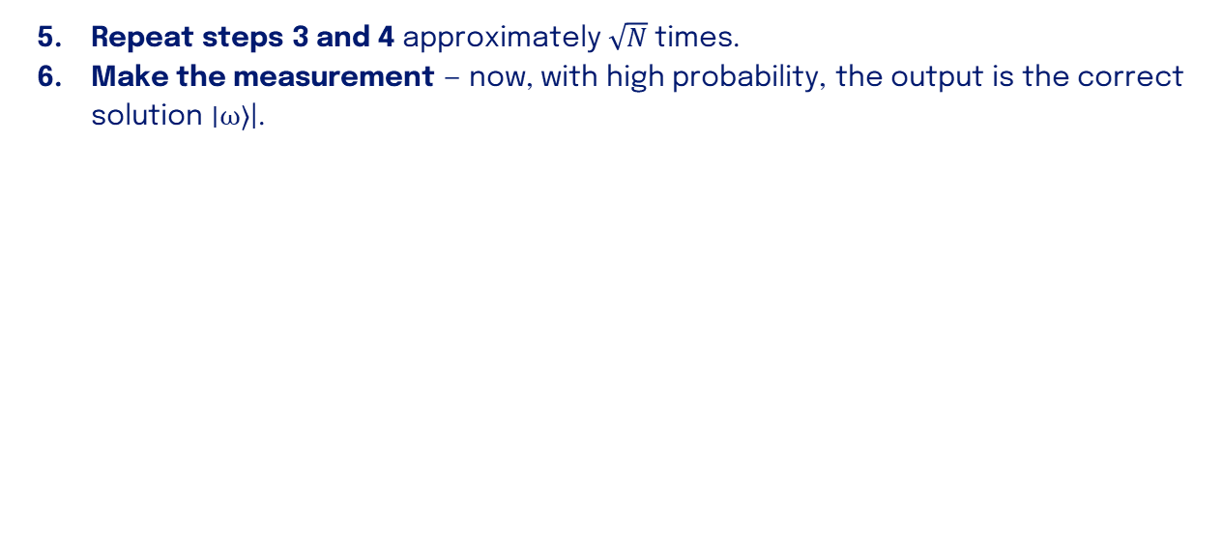
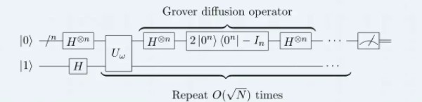
Algorithm’s steps
(Complexity) where K=⌊𝜋/4 √(𝑁/𝑎)​​⌋
●

Slide 15

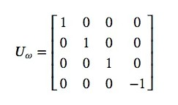
Grover’s implementation
Our computations will be based on 2 quibits.
In particular, we are going to be looking for w = |11>.
It turns out that in this case, the quantum oracle will look like:
Or

Slide 16
Limitations:
1- require to know number of solution
K=⌊𝜋/4 √(𝑁/𝑎)​​⌋
2- only works with unstructured data
if data structure then it should be done with classical will be much faster (binary search (O(logN))
3- only quadratic speedup
it only speed to O(√N) so if n = 128
then classical will be 2^128In quantum will be 2^64 which still large

Slide 17
Thank You

